Slide 1
Body Percentage Project
Brendan O’Connor

Slide 2
Description of Problem
Weight continues to be a problem for much of the world. Closely linked with this problem is body fat percentage as it is a more precise metric to indicate the health of the individual. The problem with calculating body fat percentage is to do it accurately you need trained experts and uncommon tools for measurement (pool with precise volume measurements). The goal of this project was to try and develop a model, albeit imprecise, to attempt to give an individual an estimated body fat percentage from as few, simple, measurements that can be made with household items.

Slide 3
Data Set
Data set provided by cmu at: http://lib.stat.cmu.edu/datasets/bodyfat
Body fat measurements were determined on a set of 252 men by trained experts
Various other features were also recorded at the time:

Slide 4
Data Set
Age (years) Weight (lbs) Height (inches) Neck circumference (cm) Chest circumference (cm) Abdomen 2 circumference (cm) Hip circumference (cm) Thigh circumference (cm) Knee circumference (cm) Ankle circumference (cm) Biceps (extended) circumference (cm) Forearm circumference (cm) Wrist circumference (cm)

Slide 5
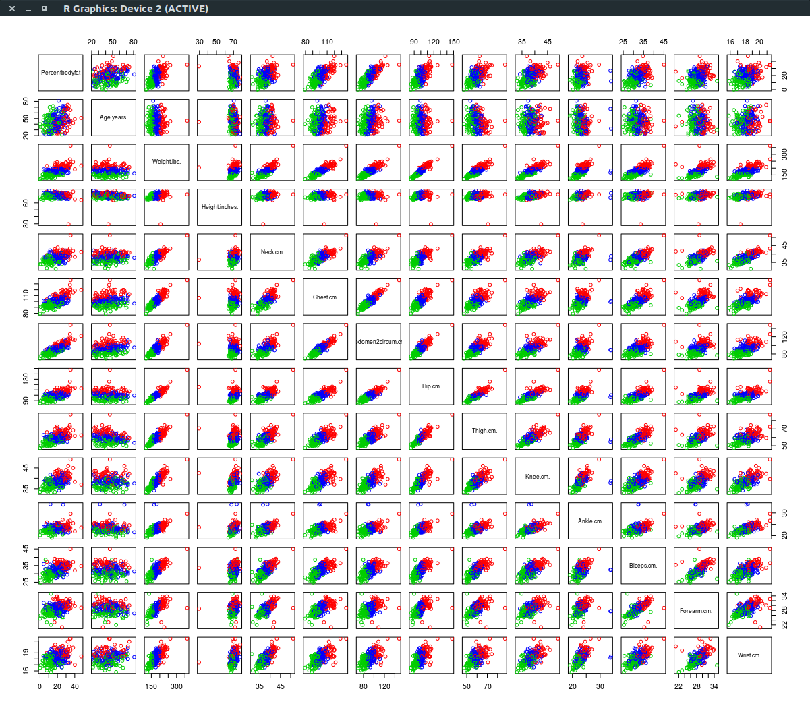
Exploring the data
First part was attempting to get an intuition on the data by plotting a scatter plot
After that looked into some unsupervised methods to help make sense of the data
With k means performed scatter plot again to see results

Slide 6
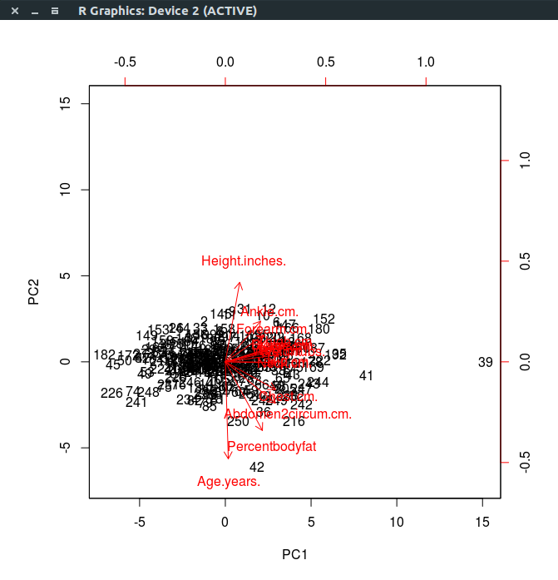
Considerations
Because I wanted this to be as “no frills” as possible to increase the chance someone curious my do it I wanted to reduce the number of measurements to the most important
As a result though could not consider PCA because the new space projected into would lose interpretability and defeat the purpose

Slide 7
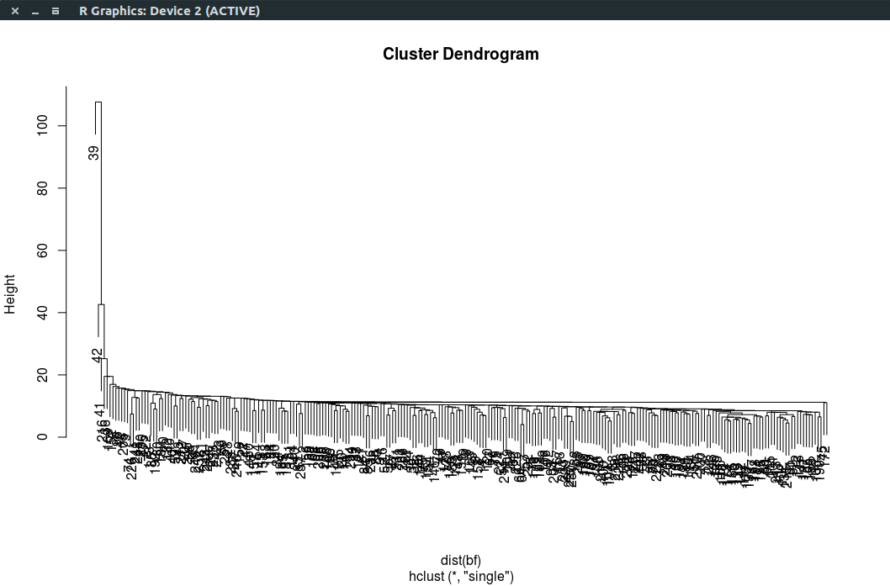
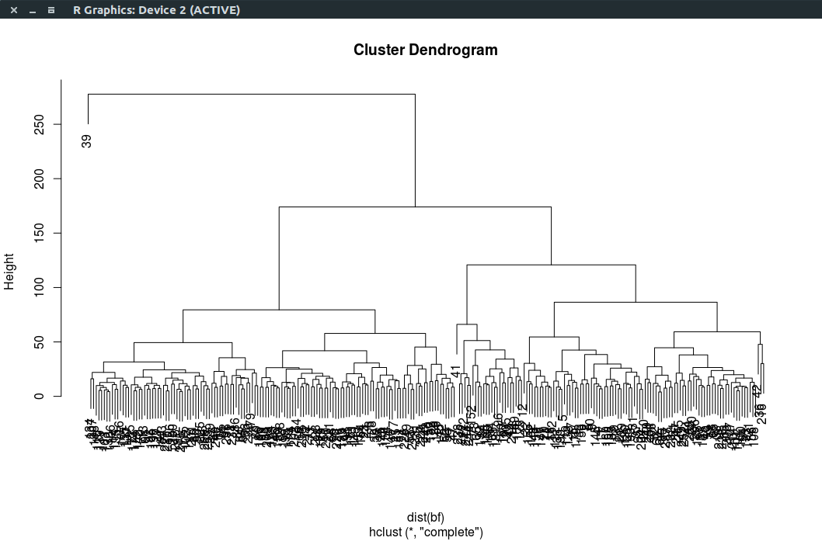
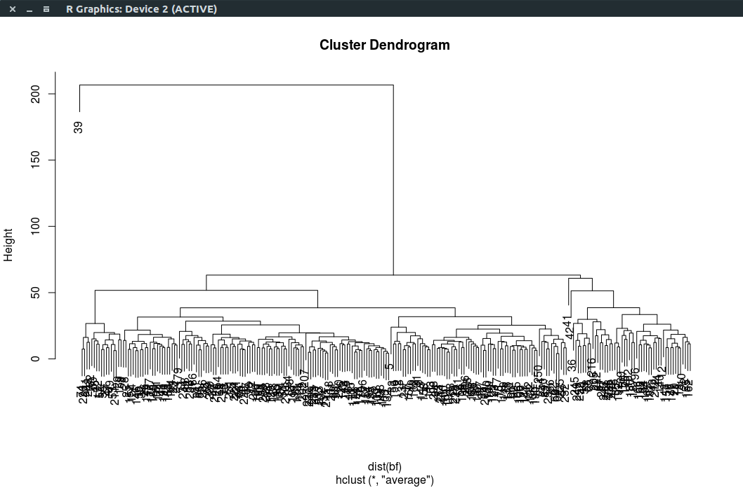
Considerations
Attempted Hierarchical clustering but didn’t feel it contributed much to understanding

Slide 8
Considerations
Also considered looking into using a tree approach
May have been useful for understanding the data but didn’t perform
Data looked too linear for a tree approach to seem worthwhile
Other flexible approaches (splines, GAMs, etc.)
Didn’t seem to make sense due to looking pretty linear
Didn’t want to overfit and capture noise in the data set

Slide 9
Exploration reflections
Much of the unsupervised approaches didn’t seem to make much sense save the clustering
The clustering was interesting because k=3 mean resulted naturally in a “low”-”med”-”high” partition of the data set that was informative
Eventually used at a later point
Alternative for dimensionality reduction that preserved end interpretability for the user was best subset selection

Slide 10
Subsets
Best subsets appeared to be pretty good in informing which features were important (and matched up later with significance test from linear model)
Top features selected:
Abdomen2cir, wrist, forearm, neck, weight, age

Slide 11
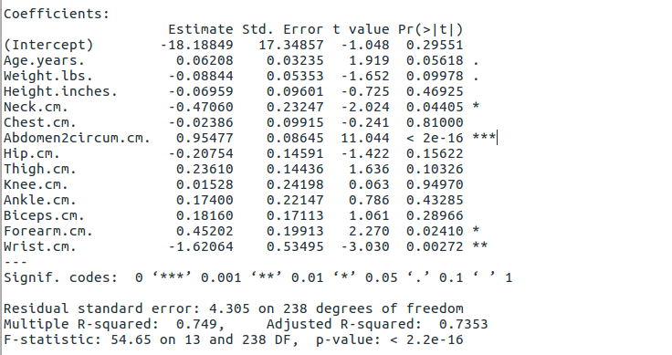
Linear Model
Worked a lot better (as expected)
We see from the significance tests that the same top variables as best subsets overlap with the linear indicating these are probably the best minimal subset
R^2 = .7353 which is fairly good with everything considered
MSE = 24.8 (mean bfp = ~19.1) which is suboptimal but within workable for an “at home” solution

Slide 12
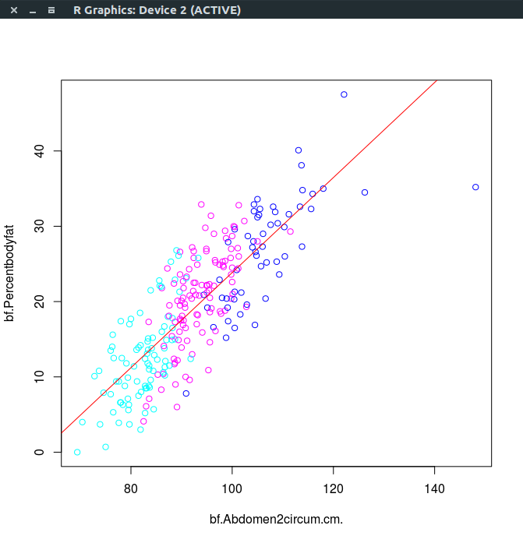
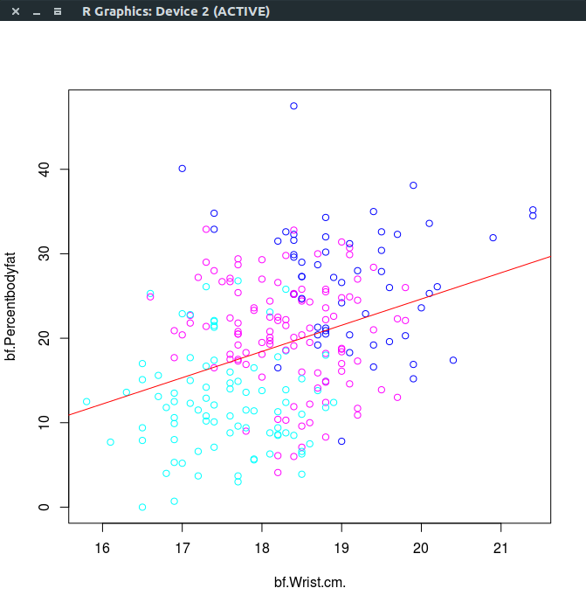
Linear Model
Ultimately much of the data indicated that linear was the best approach
Intuitively it made sense in retrospect since you would expect the body fat percentage to grow in some linear fashion to weight and size measurements

Slide 13
“High Risk” Classification
Two different approaches tried:
Using k=3 means clustering selected the “highest” mean as the high risk category and used a logistic regression to classify as high risk or not
Using the linear regression classified the top ⅓ in body fat percentage as high risk and used this threshold to classify individuals
Used validation set to test for misclassification

Slide 14
“High Risk” Classification
K-Means approach
Pretty poor results, not helped by the fact that the k-means between SS /
total SS = 61.8% (not that much higher than random guessing)
glm.pred 0 1
0 30 26
1 4 3
> mean(glm.pred == reducedbf[test,]$highrisk)
[1] 0.5238095

Slide 15
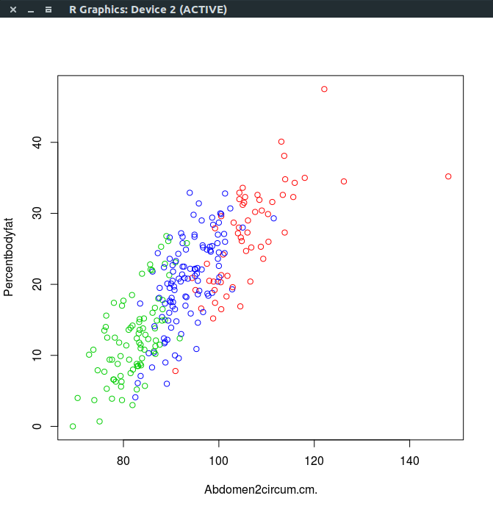
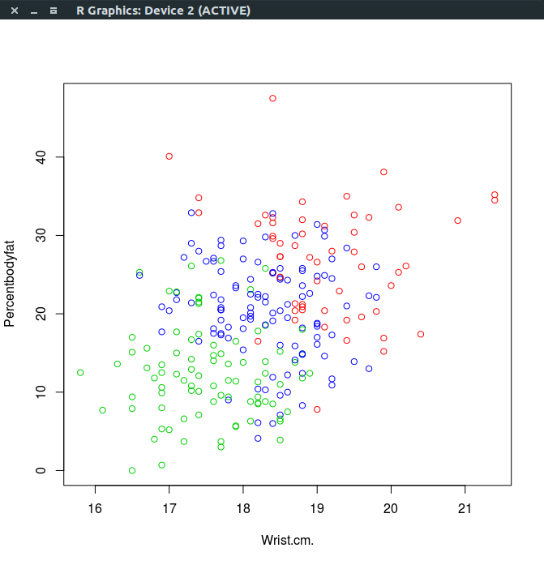
“High Risk” Classification

Slide 16
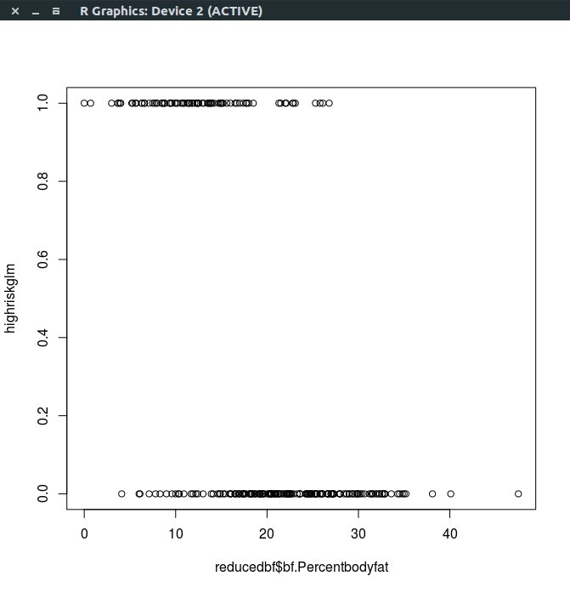
“High Risk” Classification

Slide 17
“High Risk” Classification
In comparison linear model performed drastically better: > mean(highrisk == (reducedbf[test,]$bf.Percentbodyfat >= 15))
[1] 0.952381
> table(highrisk,reducedbf[test,]$bf.Percentbodyfat >= 15)
Highrisk 0 1
0 16 1
1 2 44
This success rate seemed pretty high relative to the r^2 and mse but this implies that it was precise enough to perform well in the classifications

Slide 18
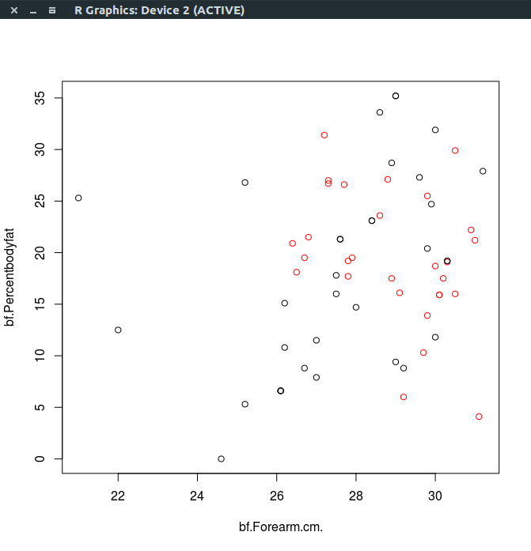
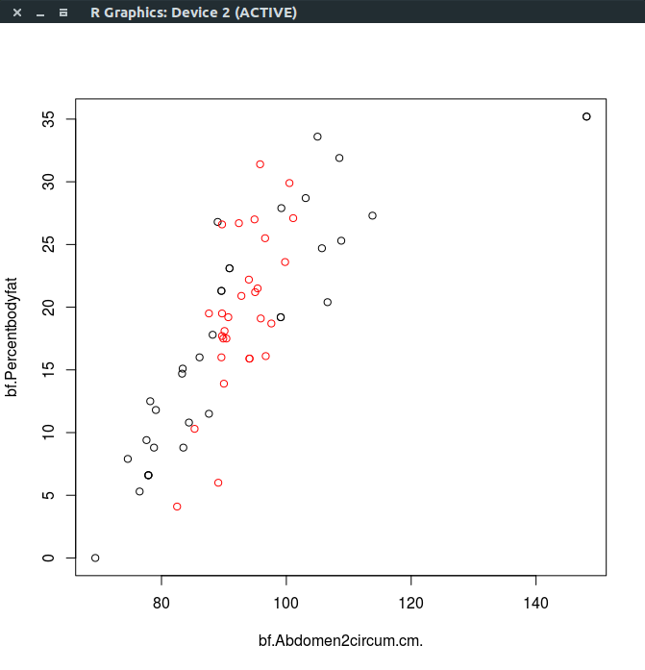
“High Risk” Classification
I did think I was expecting the linear model to classify the high risk categories into more of a partition much like the k=3 clusters did

Slide 19
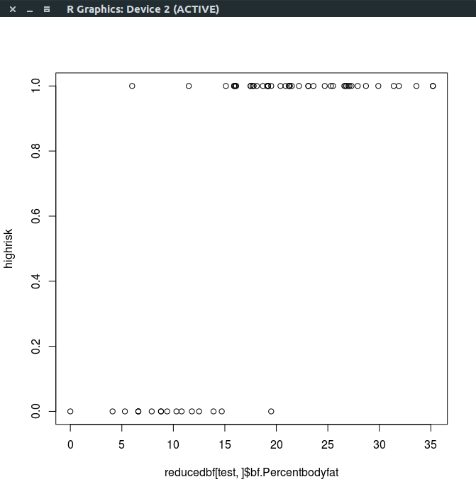
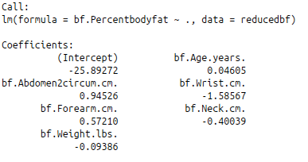
“High Risk” Classification

Slide 20
Conclusions
The good ol’ linear regression still has use these days
Despite complicated models the linear model performed vastly well
Based on the classification rates this model seems like a good desired end result
Provides a quick and easy way that someone at home could determine if their body fat percentage is “high risk”

